Slide 1
Minutes of a Meeting

Slide 2

Agenda
What is a meeting?
How to organize a meeting?
Preparing the Agenda of a Meeting
Writing the minutes of a Meeting

Slide 3
What is a Meeting?
A business meeting is a gathering of two or more people to discuss ideas, goals, and objectives that concern the workplace.
The primary purpose of any meeting is to address the issues which affect the productivity and operations of a company.
Business meetings can be conducted in person at an office or at a different location, or even over the phone and by video conference.

Slide 4

Without Meetings
a business will fail to sort out the basic issues or to boost the range of the business, and this may cause a massive loss or a great miscommunication among the top authorities.

Slide 5

How to Organize a Meeting?
The following questions will guide you in arranging meetings:
Why do you need the meeting?
How many attendees will there be?
Who are the attendees?
What are their contact details?
When should the meeting take place?
What style of seating do you need (boardroom, lecture theatre, circle of chairs)?
Is a seating plan needed?
What equipment do you need for any presentations?
Where is the best location?
What refreshments are needed?

Slide 6

Preparing the Agenda of a Meeting
Based on the information gathered from the set of questions used to organize meetings, prepare the agenda of the meeting.
An agenda is essentially a meeting plan that outlines what topics will be discussed and in what order. Agenda items depend on the meeting’s purpose and the needs of your business or team.
Discussion Question:
Can there be a business meeting without an AGENDA?

Slide 7
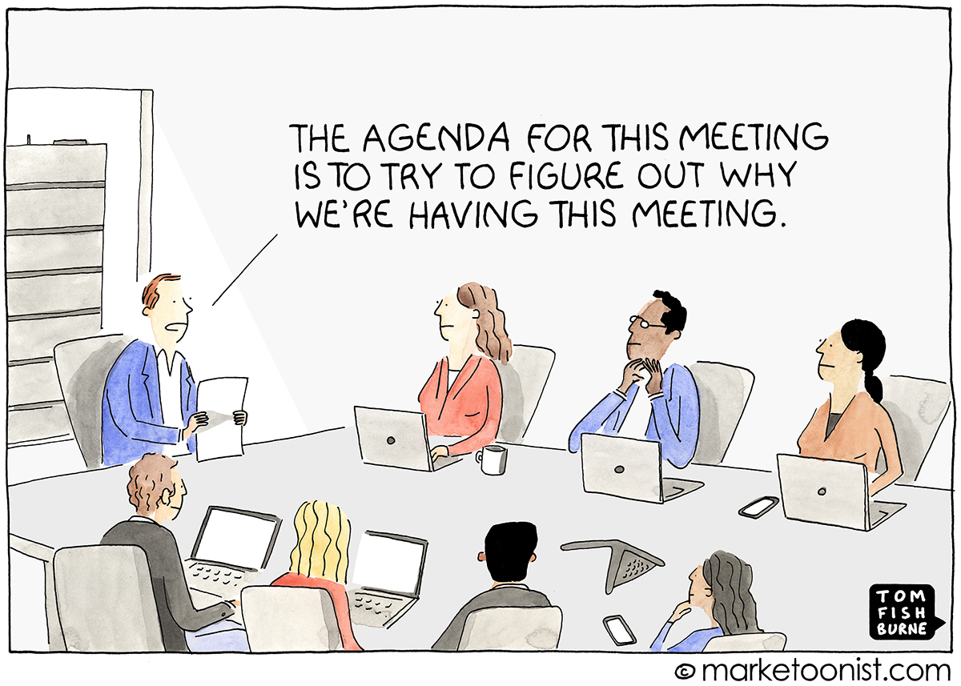

Slide 8
Example of a Meeting’s Agenda
AGENDA for the staff meeting on Weds 4th April
1. Apologies
2. Minutes of the previous meeting
3. Matters arising
4. Staff canteen accounts
5. Reception refurbishment
6. Student placements
7. Summer barbeque
8. Any other business
9. Date of next meeting

Slide 9

After the agenda is ready,
Send a memo or an email message to all the attendees with details on the following:
Date of meeting
Time of meeting
Venue of Meeting
Duration of the Meeting
Agenda of the Meeting
Give specific instructions to participants about what is expected of them.
Remember to be friendly and motivate the participants to attend the meeting.

Slide 10
Writing the minutes of a Meeting
You need three skills for this.
Active Listening
Note-taking
Tact and Diplomacy

Slide 11
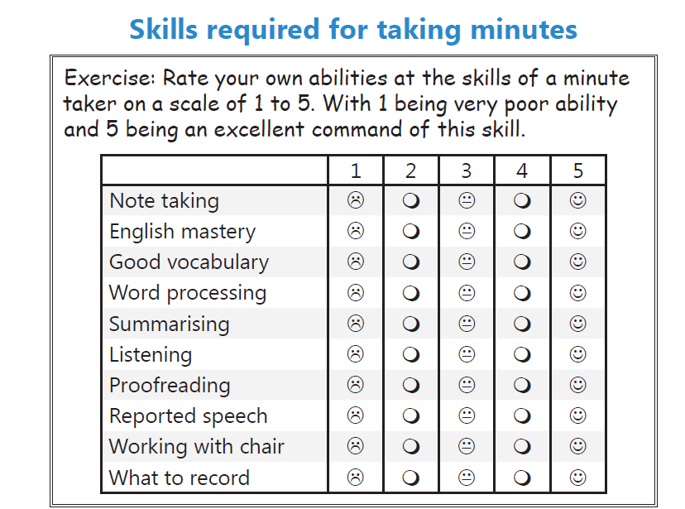
Assess Yourself

Slide 12
Some Advice on Note-taking
On a clean sheet of paper, prepare an outline based on the agenda ahead of time
Leave plenty of white space for notes.
By having the topics already written down, you can jump right on to a new topic without pause.
Pass around an attendance sheet for everyone to sign as the meeting starts.
Make sure to ask for introductions of unfamiliar people.
Concentrate on getting the gist of the discussion and taking enough notes to summarize it later.
Use whatever device is comfortable for you, a notepad, a laptop computer, a tape recorder (if allowed).
Study the issues to be discussed and ask a lot of questions ahead of time.
Don't wait too long to type up the minutes.

Slide 13
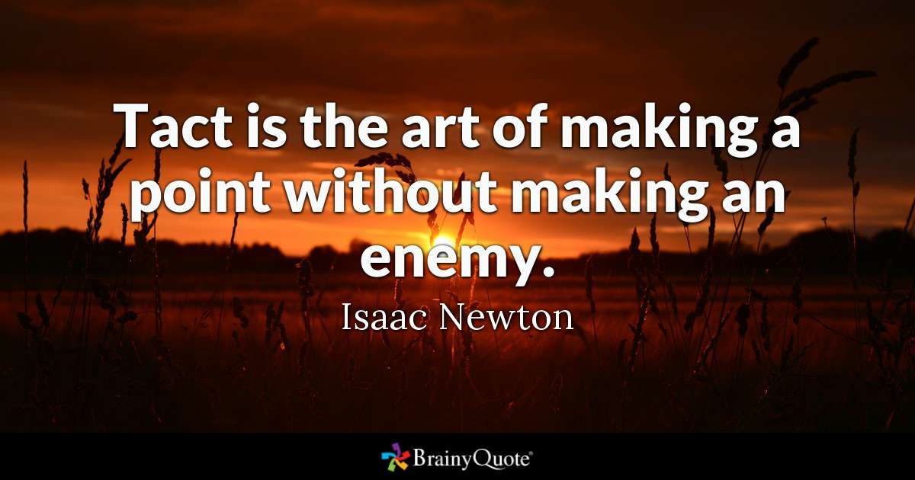
Tact and Diplomacy
Remember the 4 Goals of Business Communication.

Slide 14

What are Minutes of a Meeting
Meeting minutes are the detailed notes that serve as an official written record of a meeting or conference.
The person in charge of the gathering usually asks one of the participants to tend to this task. One day, that someone could be you. While it's not a terribly difficult job, taking minutes is an important one.

Slide 15
Types of Minutes
Types | Meanings
Verbatim minutes (word-for-word records of what was said) | They are like transcripts which present a record of every single word said at a meeting. They are used for any type of meeting at which every word that was said must be captured —usually a legal context, at the advice of legal counsel
Decision-only minutes (motions or decisions only – no shred of discussion) | For formal meetings that require the formal approvals, like for your Audited Financial Statements; or an appointment of a Director of a Board, or a President; or for meetings at which you carry out all business through motions.
Anecdotal minutes (decisions and discussion summaries) | For department/team meetings throughout the organization; for brainstorming sessions; the most common and are used for many types of meetings—the key with anecdotal minutes is what to record

Slide 16
Can you guess the type of minutes by reading the extracts taken from the minutes?
GUESS: Verbatim, Decisions-only, or Anecdote
The report provided by the Treasurer on the renovation of the Board Room included the following: Total income from the government, funding projects, and management Total expenses for the renovation Amount of money left after all expenses paid Members gave input on how to use the surplus money, including: To upgrade the elevator Reserve for future unexpected capital needs Pay down cost of new technical equipment for board room Decision: It was decided that the surplus will be kept in reserve for future unexpected capital needs. Action: The Treasurer will bring a report to the next Audit Committee meeting on the current status of the reserve fund.
The maximum budget of $150,000 for adding four vehicles to the fleet was approved, effective June 30, 2016. The Director of Transportation will proceed with the purchase. Moved that the Expense Report for the first quarter, ending March 01, 2016, be approved. Smith/Jones Carried The President will arrange for a meeting with the city’s Department of Senior’s Services to discuss a potential partnership to expand transportation services for seniors in our institutions. Members will be advised of the date as soon as it is confirmed.

Slide 17
Can you guess the type of minutes by reading the extracts taken from the minutes?
GUESS: Verbatim, Decisions-only, or Anecdote
The Speaker: Now other guests. The Minister of Education and Minister of Culture and Tourism. Mr. Eggen: Well, thank you, Mr. Speaker. I would like to introduce through you and to you two people that are very important to me, my wife, Somboon, and my eldest daughter, Genevieve. They, of course, have seen the Legislature before – I’ve been here since 2004 – but they’ve never seen it quite like this. Genevieve just came back – she was away for five weeks or so – and came home and asked, “Dad, what have you been up to?” I said, “Oh, not too much, but why don’t you come by and see how things are?” It’s very exciting for them to be here today. I also just wanted to very briefly express my admiration for Dave Hancock. You know, I’ve only been doing this for about a month or so, and I’m just so tired. Dave has always been someone I looked up to and tried to emulate in so many ways, and I just wanted to mention that, too. If my family could stand, please, and receive the warm welcome of the House.

Slide 18
Before we proceed, study these three key terms
Term | Meaning
Motion | A motion is a proposal that is put before a meeting for discussion and a decision.
Resolution | If a motion is passed it becomes a resolution. Resolutions are binding and should be recorded in the minutes of the meeting.
Actions | An action item is an action or a task that’s assigned to one or more meeting participants. The idea is that this person or these people report back when they’ve completed the task.

Slide 19

Anecdotal Minutes- Components and Format
Provide Logistical Details of the Meeting
Provide the Anecdotal Record

Slide 20
Anecdotal Minutes- Components and Format
I. Provide a Record of the Logistical Details of the Meeting
This refers to the following information:
1.the name of the group or committee that met 2.the location, date, and time of the meeting 3.the type of meeting (regular or special) 4.the presence of the chair and secretary, or their substitutes 5.the time at which the meeting was adjourned
Also record what action was taken about the minutes of the previous meeting. For example, the minutes were read (or distributed) and approved (or amended and approved). You should record any changes to the previous minutes.

Slide 21
Anecdotal Minutes- Components and Format
II. Provide the Anecdotal Record
Remember Anecdotal minutes = Summary of discussion + resolution or action
Record the topics discussed (refer to agenda) at the meeting as well as any actions taken. For example, write down the names of reports read or approved, motions made (and whether they were approved, defeated, or tabled), and resolutions adopted.
Record the outcomes of discussions. Record the names of the people who made motions, read reports, and so forth.
Structure discussion points in a logical order, not in the sequence they occurred.
Often visual aids or other materials are used as references for the discussion. Include these items in the minutes so that the reader has the appropriate information required to understand the conversation.

Slide 22
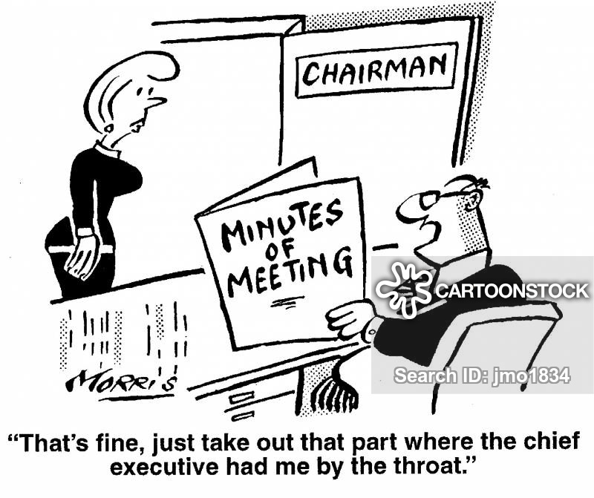
Remember Tact and Diplomacy

Slide 23
Remember Tact and Diplomacy
Your task in recording the minutes includes separating the substance of the meeting from the emotional exchanges of participants.
Do not write: "The motion to add a new position in the QA Department was defeated 7 to 6 after a heated argument in which Bob Minor complained that 'Alice states that she-supports my department, but when it comes to action, she's all talk.' "
Reflect Positively on the Participants and the Organization

Slide 24
Important
Refer to handouts for samples and more details.

Slide 25
For Indirect Speech
https://owlcation.com/humanities/Indirect-Speech
https://dictionary.cambridge.org/grammar/british-grammar/reported-speech-indirect-speech
https://www.wallstreetenglish.com/blog/direct-and-indirect-speech-exercises/
https://www.studyandexam.com/direct-indirect-speech.html

